Slide 1

Light Behaviour
Chapter 11.1 pages 358 - 361

Slide 2

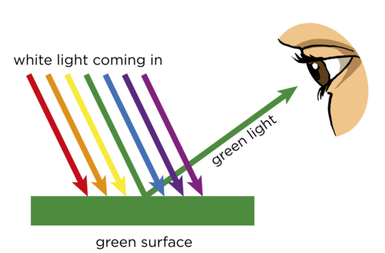
Nature of Light

Slide 3
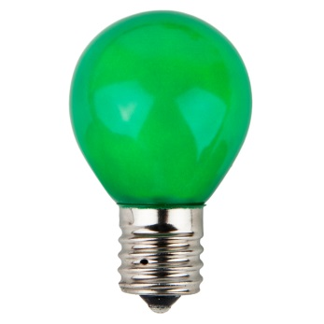
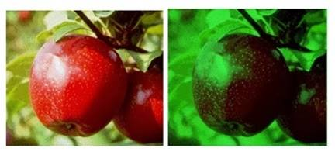
Nature of Light
What colour would we see now for;
a) the apple
b) the background

Slide 4
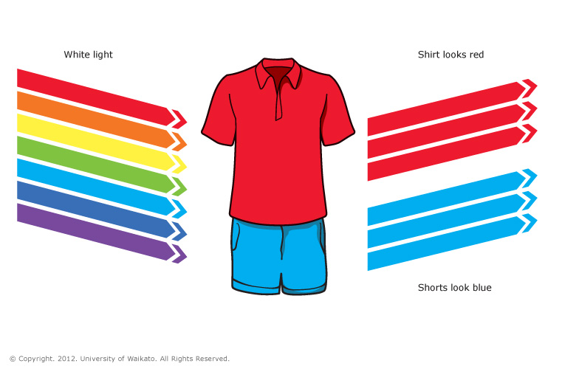
Nature of Light

Slide 5
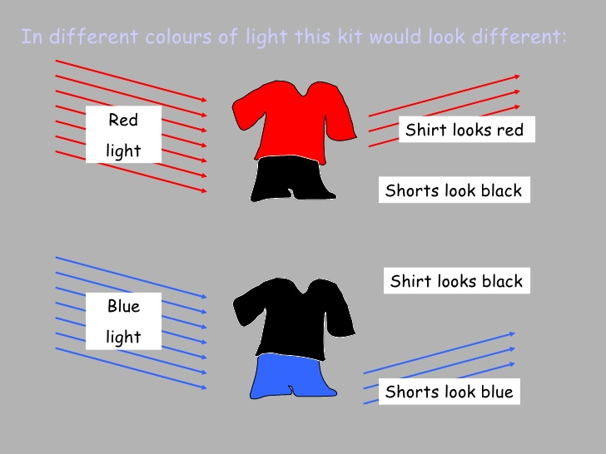
Nature of Light

Slide 6
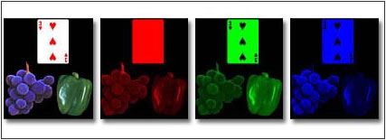
Nature of Light

Slide 7
Nature of Light
Light is usually described as being both particle-like (due to photoelectric effect) and wave-like (Young’s double slit experiment) in its behaviour. However, there are three models used to explain it.
Ray model.
Wave model.
Photon (particle) model.

Slide 8
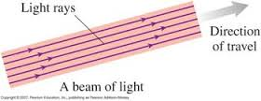
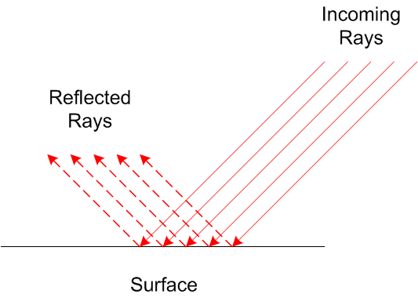
Ray Model
Straight line.
Changes directions when interacting with materials.

Slide 9
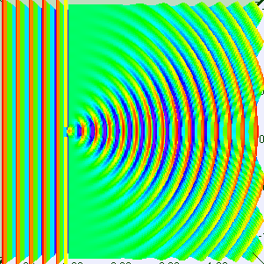
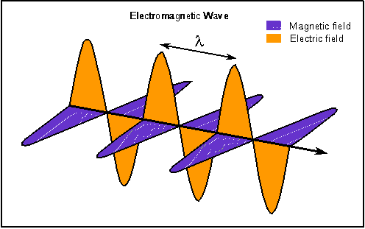
Wave Model
Interference and Diffraction.
Electromagnetic wave in a vacuum or a medium.

Slide 10
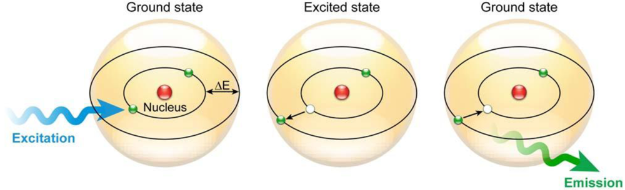
Photon Model
Photons act as packets of particles that allows interaction with atoms.

Slide 11
Homework, Context & Keywords
Homework
Complete all questions from Set 11.1 - due first lesson next week.
Read Chapter 11.2, page 361-367 and answer
Q1, Q2 & Q3 Set 11.2
by next lesson.

Slide 12
Electromagnetic Radiation
Chapter 11.2 pages 361 - 367

Slide 13
Family of Electromagnetic Radiation
In 1864, James Maxwell, explained the electromagnetic nature of light. He proposed that an oscillating electric charge (or current) will produce an oscillating magnetic field, which in turns produces an oscillating electric charge. This process becomes self-sustaining at the speed 3.00 x 10⁸ ms⁻¹.

Slide 14
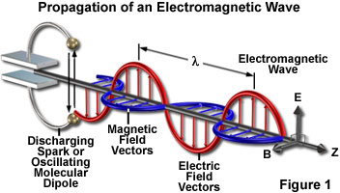
Family of Electromagnetic Radiation
Electro..... Magnetic!
c = f λ, where c is constant.

Slide 15
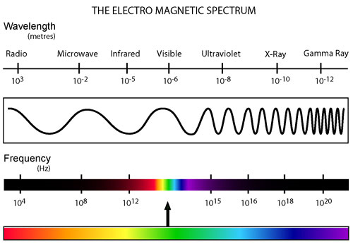
Family of Electromagnetic Radiation

Slide 16
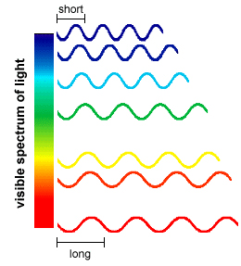
Family of Electromagnetic Radiation
Light is part of the electromagnetic family, each with its unique wavelength and corresponding frequency. All have the same velocity, known as the speed of light:
c = 3.00 x 10⁸ ms⁻¹.
Within the spectrum of light radiation the wavelength is varying.

Slide 17
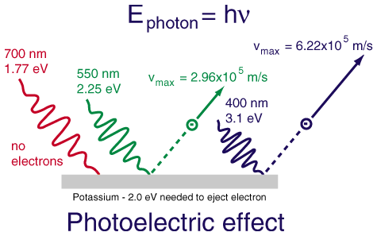
Particle-Like Properties
The photoelectric principle was demonstrated to show that when light shines on a piece of metal, depending on the
type of metal and the frequency of light, then this could produce a current (the movement of electrons).

Slide 18
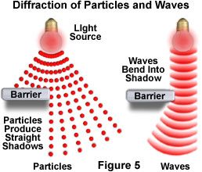
Wave-Like Properties
The fact that light is able to “bend” around obstacles, which is a property of transverse waves, shows light to have wave-like properties.
This phenomenon is known as diffraction.

Slide 19
Speed of Light in Different Mediums
Einstein's Theory of Relativity.
Nothing can travel faster than the speed of light in a vacuum.
Light in a vacuum always travels at the same speed.
c = 1 .
√ε μ
where
ε (electric permittivity) is the resistance that is encountered when forming an electric field in a medium.
μ (magnetic permeability) is the ability of a material to support the formation of a magnetic field within itself.
Air

Slide 20
Speed of Light in Different Mediums
Generally, the refractive index (Chapter 11.4) is used to determine the speed of light in a given object relative to speed of light in a vacuum.
c = nv
c – speed of light in a vacuum
n – refractive index of medium
v – speed of light in a medium
So take speed of light in crown glass
material | n
Vacuum | 1
Air | 1.0003
Water | 1.33
Ethyl Alcohol | 1.36
Fused Quartz | 1.4585
Whale Oil | 1.460
Crown Glass | 1.52
Salt | 1.54
Asphalt | 1.635
Heavy Flint Glass | 1.65
Diamond | 2.42

Slide 21
Example 11.2 a
The SBS television station transmits its vision signal on 527.25 MHz and its sound signal on 532.75 MHz. What is the wavelengths of each of these signals?
Solution

Slide 22
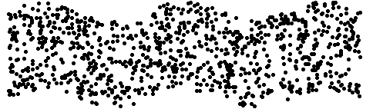
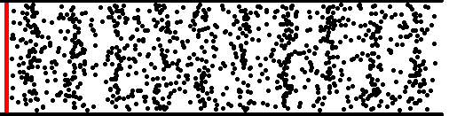
Wave types
Transverse wave in a liquid
Longitudinal wave in a gas

Slide 23
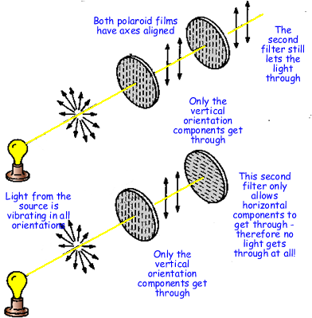
Polarisation
Applicable only to transverse waves (longitudinal waves cannot be polarised). Hence light waves (the wave component of light) acts as a Transverse wave.

Slide 24
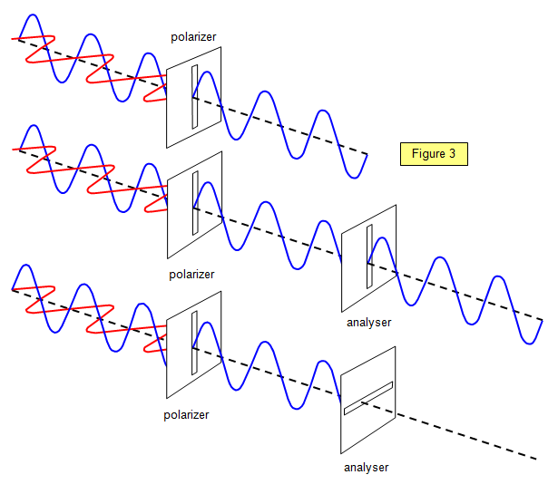
Polarisation
With polarisation, consider the effect on the electric component of the EM when passed through the polarising planes.

Slide 25
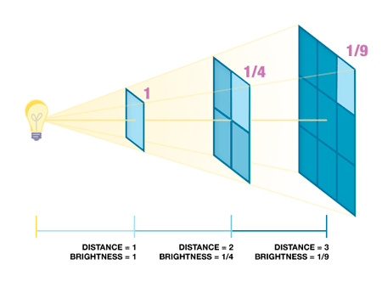
Inverse Square Law
I α 1
r² where 1 is for the spherical
4 π behaviour, but we only look at it in a singular plane.

Slide 26
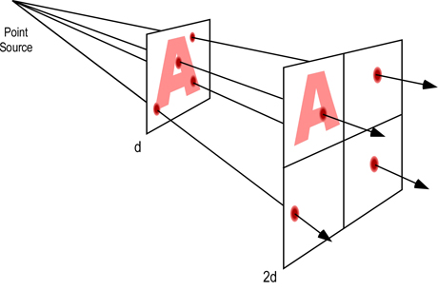
Inverse Square Law
As the length doubles, the area quadruples (x4) and so the intensity decreases by a factor of 4.

Slide 27
Homework, Context & Keywords
Homework
Complete all questions from Set 11.2 - due first lesson next week.
Read Chapter 11.3, page 368-371 and answer
Q1 & Q2 Set 11.3
by next lesson.

Slide 28
Reflection of Light
Chapter 11.3 pages 368 - 371

Slide 29
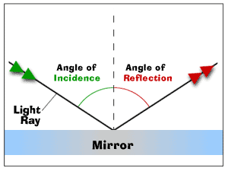
Reflection
When the wave does not pass through the solid barrier it encounters. The light ray that hits the mirror is called the incident
ray. The light ray that
bounces off the mirror is
called the reflected ray.
Law of reflection
Angle of incidence (θ_{i}) = Angle of reflection (θ_{r})
Incidence ray and reflected ray are on the opposite sides of the normal.

Slide 30
Reflection
Any type of wave can be reflected, e.g. Sound, Water and Light Waves.
Reflection best occurs from flat, hard surfaces.
After reflection, a wave has the same speed, frequency and wavelength, it is only the direction of the wave that has changed.

Slide 31
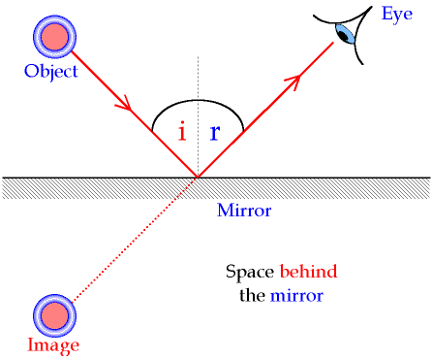
Reflection
The image appears to be the same distance behind the mirror as the real object is in front of it. This is because the brain thinks that light travels in straight lines without changing direction. The image is called virtual because the light rays (shown as dotted
lines) never really go there
(compare this with a real
Object (image)). The virtual
image in a mirror is the same
size as the object but with left
and right reversed.

Slide 32
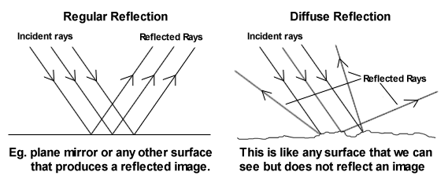
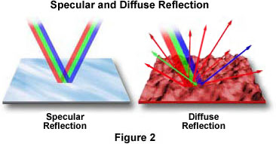
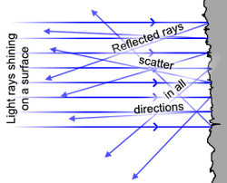
Reflection

Slide 33
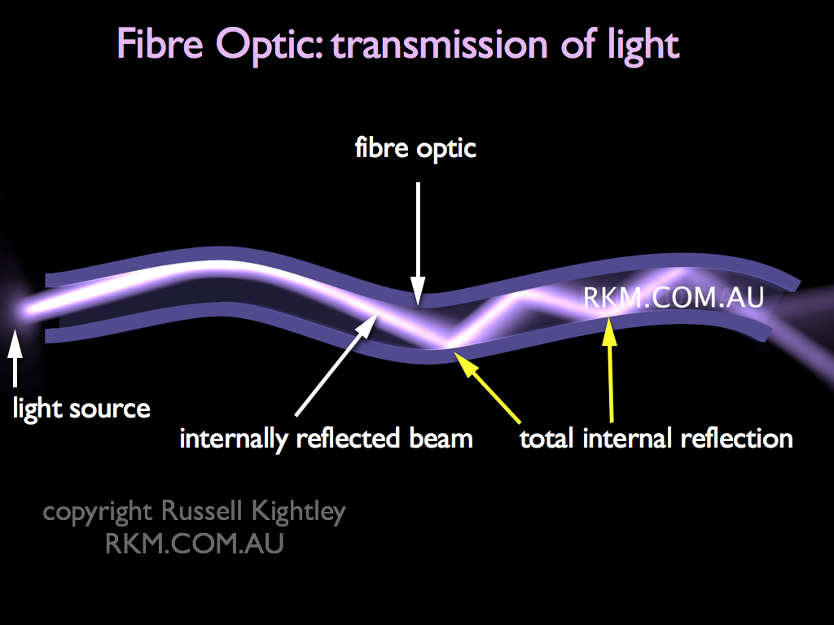
Optic Fibres
Fibre-optic lines are strands of optically pure glass as thin as a human hair that carry digital information in the form of light pulses over long distances.
Cables can bend as the system relies on reflection to keep the light pulse within the glass strand. Very little light is absorbed by the glass. Light
getting in at one end
undergoes repeated total
internal reflection, even
when the fibre is bent, and
emerges at the other end.

Slide 34
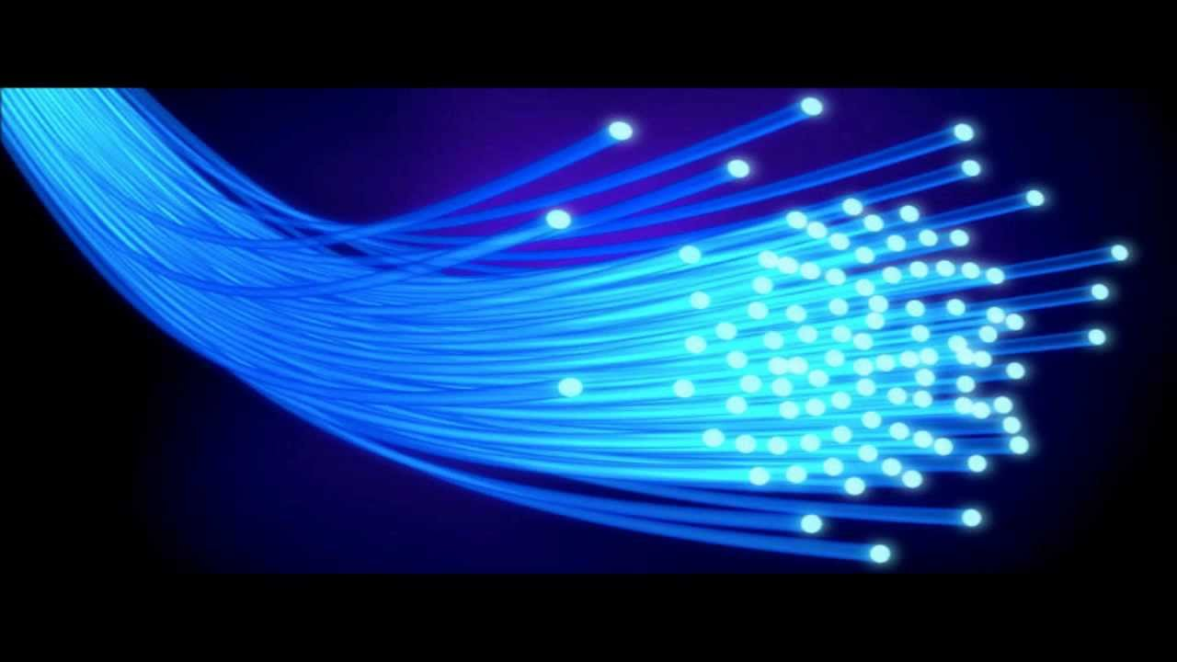
Optic Fibres
The speed of light is approximately 300,000,000 metres per second. Fibre optic networks, which carry laser light information signals, are moving that speed.
As the laser-generated pulses of light reach the subscriber's home, a converter changes them into the electrical impulses that
computers use. They are also
used in medical imaging and
mechanical engineering
inspection.

Slide 35

Reflection

Slide 36
Homework, Context & Keywords
Homework
Complete all questions from Set 11.3 - due first lesson next week.
Read Chapter 11.4, page 371-380 and answer
Q1 Q2 & Q3 Set 11.4
by next lesson.

Slide 37
Refraction of Light
Chapter 11.4 pages 371 - 380

Slide 38
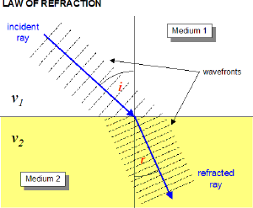
Refraction
c = λ × f
Refraction is a phenomenon that often occurs when waves travel from a medium with a given refractive index to a medium with another at an
oblique angle. At the boundary
between the media, the wave's
phase velocity is altered, usually
causing a change in direction. Its
wavelength increases or decreases
but its frequency remains constant.

Slide 39
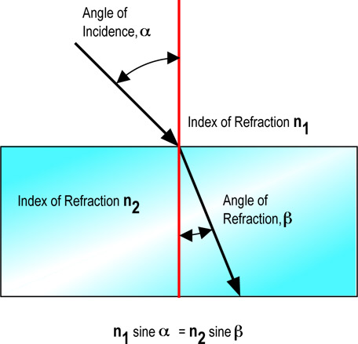
Refraction
Refraction is the bending of a wave when it enters a medium where its speed is different.
The refraction of light when it passes from a “less dense” medium to a “more dense” medium bends the light ray toward the normal to the boundary
between the two media. The amount
of bending depends on the “Indices
of Refraction” of the two media and
is described quantitatively by Snell's
Law.
Angle of Incidence, i
Index of Refraction, n₁
Index of Refraction, n₂
Angle of Refraction, r
n₁ × sin i = n₂ × sin r

Slide 40
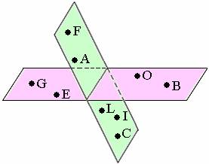
Refraction
Law of Refraction
A change in medium must occur.
The light wave does not enter the
new medium to the normal.
The incidence ray, the normal and
refracted ray are all coplanar.
F, A, L, I, C are coplanar
G, E, O, B are coplanar
Exist on the one plane
Angle of Incidence, i
Index of Refraction, n₁
Index of Refraction, n₂
Angle of Refraction, r

Slide 41
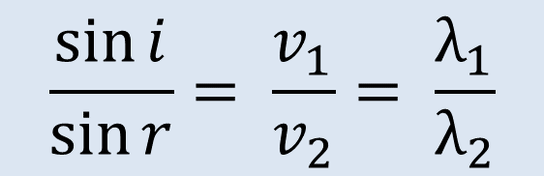
Snell’s Law
The incidence ray, the normal and refracted ray are all coplanar.
A change in medium must occur.
The light wave does not enter the
new medium to the normal.
Angle of Incidence, i
Index of Refraction, n₁
$$\frac{\sin{i}}{\sin{r}}= \frac{v_{1}}{v_{2}}= \frac{λ_{1}}{λ_{2}}$$
Index of Refraction, n₂
Angle of Refraction, r

Slide 42
Refractive Index
Refrangibility is the measure of refraction when light passes from a vacuum to a medium.
The refractive index for a vacuum is 1.00
Air has a close association to a vacuum, hence most objects are measured against air in practical experiments.
Refractive index also helps determine the speed of light in a given medium.
Material | Refractive Index
Air | 1.0003
Water | 1.3330
Glass (crown) | 1.5200
Diamond | 2.4170

Slide 43
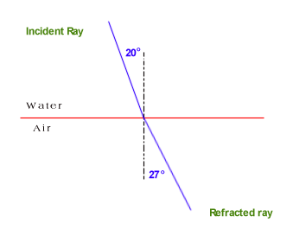
Snell’s Law
For a particular two mediums the ratio is the same.
sin i = v₁ = λ₁ = constant (n)
sin r v₂ λ₂
i | sin i | r | sin r | sin i /sin r
20 | 0.34202 | 27 | 0.45399 | 0.75336
30 | 0.5 | 41.7 | 0.66523 | 0.75162
40 | 0.64279 | 58.8 | 0.85536 | 0.75148
48 | 0.74314 | 81.3 | 0.98849 | 0.75179
48.75 | 0.75184 | 90 | 1 | 0.75184
50 | 0.76604 | 0 | 0 | und
Angle of Incidence, i
Angle of Incidence, i
Index of Refraction, n₁
Angle of Reflection, r
Index of Refraction, n₂
sin i = v_{water} = λ_{water} = 0.752
sin r v_{air} λ_{air}
Angle of Refraction, r

Slide 44
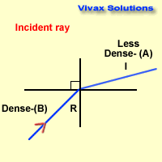
Snell’s Law
The incidence ray and refracted ray are interchangeable. That is….. (diagram below)
Hence going from water to air, has a refractive index of 0.752. So going from air to water has a refractive index of 1.33 (or 1/0.752).

Slide 45
Relative Refractive Index
Not every transference of light is going to involve air as one of the mediums.
Comparing Water with Diamond means;
Material | Refractive Index
Air | 1.0003
Water | 1.3330
Glass (crown) | 1.5200
Diamond | 2.4170

Slide 46
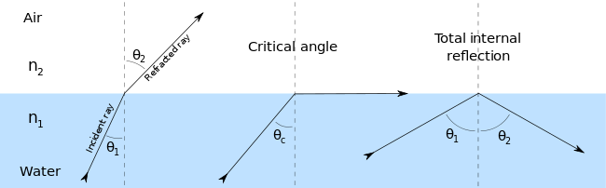
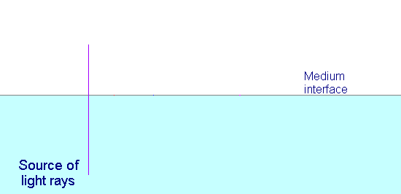
Total Internal Reflection
Angle of Incidence > Critical Angle, hence no Refraction

Slide 47
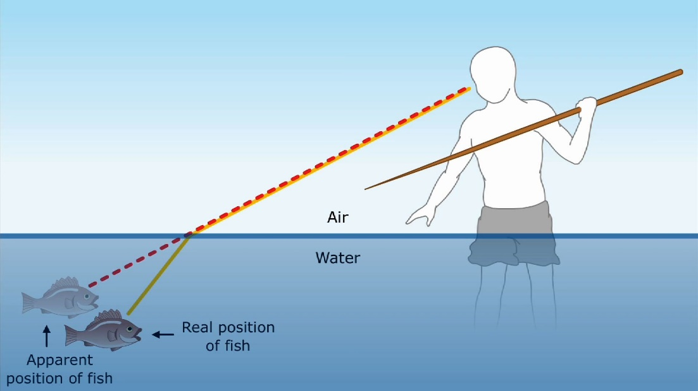
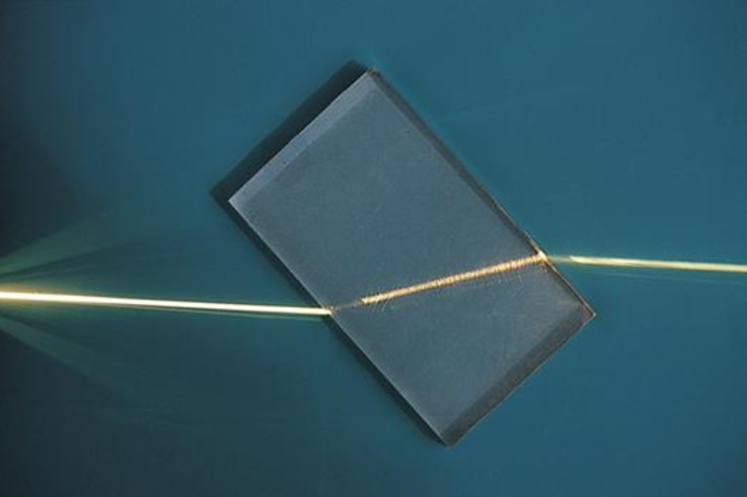
Refraction

Slide 48
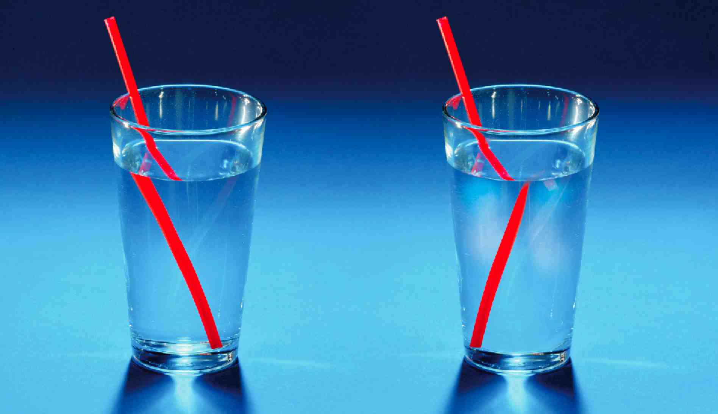
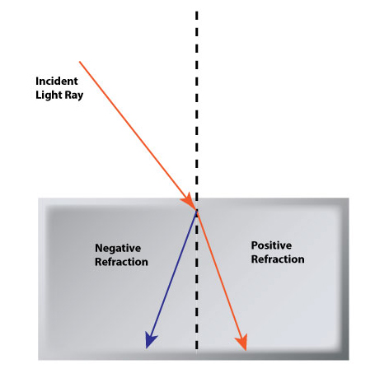
Negative Refraction
Can be determined and has a negative value over some frequency range.
n₁ = ± √ε₁μ₁ .
n₂ √ε₂μ₂
where ε (electric permittivity) is the resistance that is encountered when forming an electric field in a medium.
and μ (magnetic permeability) is the ability of a material to support the formation of a magnetic field within itself.
Positive value = Positive refraction
Negative value = Negative refraction

Slide 49
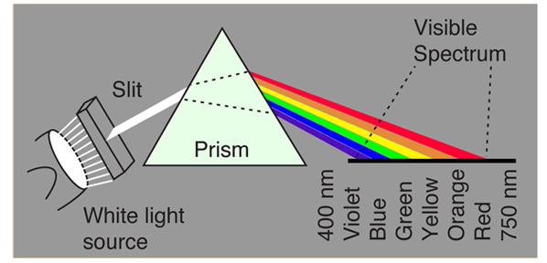
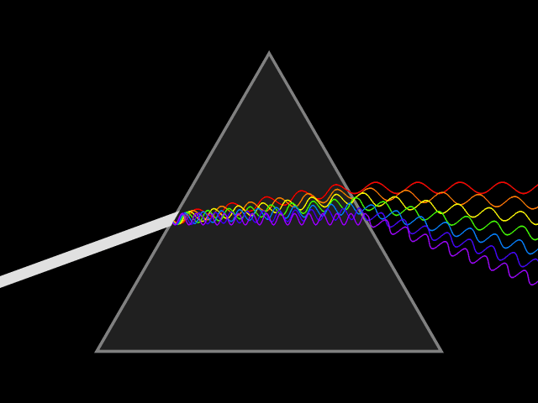
Dispersion
Remember in refraction the frequency remains constant.
Dispersion is the change of index of refraction with respects to the wavelength. Generally the index decreases as wavelength increases; blue light traveling more slowly in the material than red light causes it to refract more (move more towards the normal).

Slide 50
Homework, Context & Keywords
Homework
Complete all questions from Set 11.4 - due first lesson next week.
Read Chapter 11.5, page 381-391 and answer
Q1 Q2 & Q3 Set 11.5
by next lesson.

Slide 51
Lenses
Chapter 11.5 pages 381 - 391

Slide 52
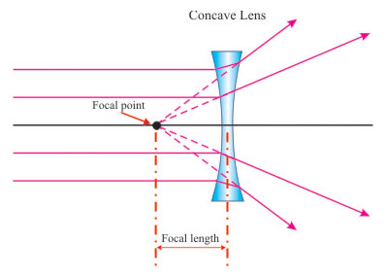
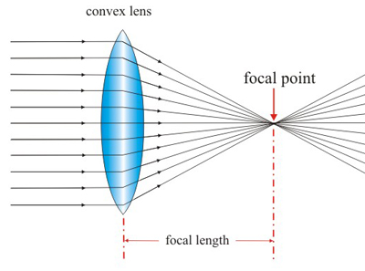
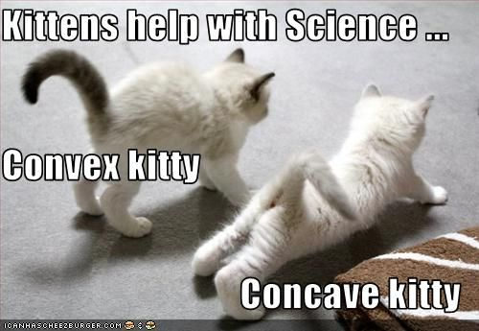
Lenses
Convex Concave
Converge Diverge

Slide 53
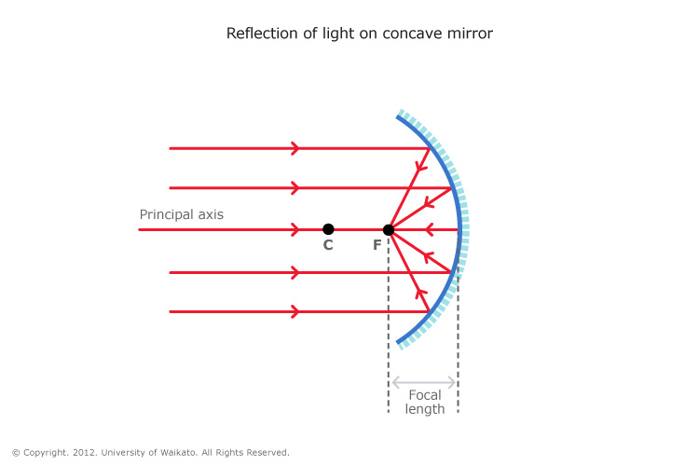
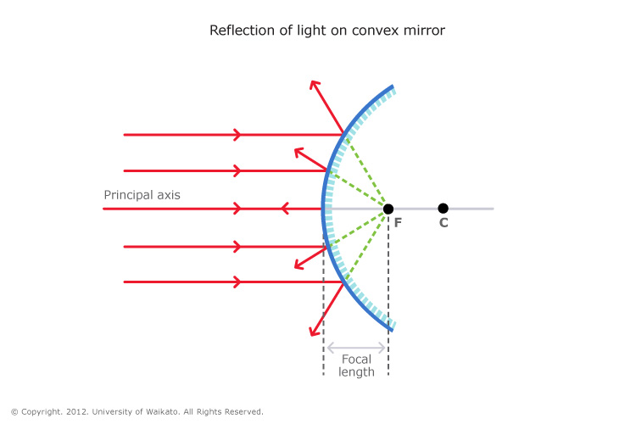
Mirrors
Concave Convex
Converge Diverge

Slide 54
Convex and Concave
Watch the video and try and collect as much information on Convex and Concave Lenses and Mirrors using the mind map technique.
This practise is to help you review YouTube clips to advance your knowledge on the topics taught here, in Physics, other subjects and future studies.
Hand out “Convex & Concave Lenses & Mirrors Mind Map”

Slide 55
Convex Len
Watch this video and try again to collect as much information on Convex Lenses using the mind map technique.
This practise is to help you review YouTube clips to advance your knowledge on the topics taught here, in Physics, other subjects and future studies.
Hand out “Convex Lenses Mind Map”

Slide 56
Concave Mirror
Watch this video and try again to collect as much information on Concave Mirrors using the mind map technique.
This practise is to help you review YouTube clips to advance your knowledge on the topics taught here, in Physics, other subjects and future studies.
Hand out “Concave Mirrors Mind Map”

Slide 57
Convex Mirror and Concave Lens
Watch this video and try again to collect as much information on Convex Mirrors and Concave Lenses using the mind map technique.
This practise is to help you review YouTube clips to advance your knowledge on the topics taught here, in Physics, other subjects and future studies.
Hand out “Convex Mirrors & Concave Lenses Mind Map”

Slide 58
Thin Lens Equation
Variable | Positive | Negative
u | Always | Never
v | Real Image | Virtual Image
h_{o} | Upwards | Downwards
h_{i} | Upwards | Downwards
f | Converging Lens | Diverging Lens
M | Upright | Inverted
1 + 1 = 1 .
u v f
M = -h_{i} = -v .
+h_{o} u

Slide 59
Homework, Context & Keywords
Homework
Complete all questions from Set 11.5 - due first lesson next week.
Read Chapter 11.6, page 392-398 and answer
Q1 & Q2 Set 11.6
by next lesson.

Slide 60
Diffraction
Chapter 11.6 pages 381 - 391

Slide 61
Nature of Light
Nature of Light
Travels in a straight line in a uniform medium
Obeys the laws of reflection
Obeys Snell’s Law of refraction
Light is usually described as being both particle-like (due to photoelectric effect) and wave-like (Young’s double slit experiment) in its behaviour.

Slide 62
Newton’s corpuscles
While considering the problem of chromatic aberration (a colour distortion of images formed by single lenses) in the telescopes of the day, Newton devised a theory for the nature of light that also attempted to explain its colour.
By passing a beam of white light through a prism, Newton showed that white light is a mixture of colours. At the time, this was a significant breakthrough, since most scientists of the day thought that colours were mixtures and that white light was pure.
As the white light passed through the prism, Newton interpreted the coloured rays of light as streams of tiny particles or ‘corpuscles’ travelling at high speed that were being sorted by the prism.

Slide 63
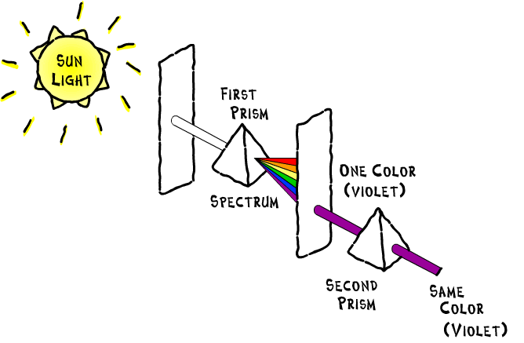
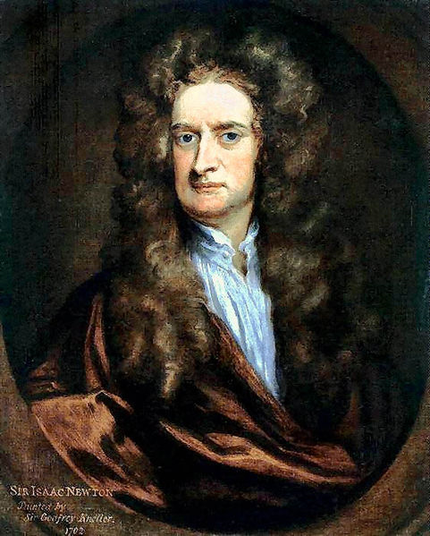
Newtons corpuscles
Light consisting of the colour spectrum was ultimately proven in 1665.

Slide 64

Diffraction
Diffraction is the slight bending of light as it passes around the edge of an object or through a slit.
The amount of bending
depends on the relative
size of the wavelength of
light to the size of the
opening.

Slide 65
Diffraction of Light
Diffraction; or the bending of light, is indicative of the properties of waves, more specifically TRANSVERSE WAVES.

Slide 66
Diffraction Angle
θ = λ
w
λ
θ
w

Slide 67


Small Diffraction Angle
θ = λ
w
θ
λ
w

Slide 68
Large Diffraction Angle
θ = λ
w
λ
θ
w

Slide 69


Single Wave Intensity
The diffraction pattern, above, is taken with a laser and a narrow single slit.

Slide 70

Single Wave Intensity
This is a snap shot of wave motion.
Remnants of previous wave
Current wave

Slide 71

Single Wave Intensity

Slide 72


Double Wave Intensity
The diffraction pattern, produced more regions of high intensity within the same region compared to single slit.

Slide 73

Double Wave Intensity
Effectively the Double Slit Intensity graph is the superposition of two Single Slit Intensity graphs set out of phase to one another. Note here that the single and double slit intensity graphs are draw to be absolute.

Slide 74

Young's Double Slit Experiment
Monochromatic light is light consisting of only one wavelength.

Slide 75

Wave-Like
The interference pattern produced on the viewing screen had strong similarities to that which occurs where water or sound waves are treated in the same manner.

Slide 76

Double Wave Intensity
The diffraction pattern, produced nodal (dark patches), like D and F. Also there are anti-nodal (bright patches), like C, E and G where the light waves interact.

Slide 77



Interference
Destructive Interference
Constructive Interference

Slide 78


Interference

Slide 79

Path Difference
There is a centre point where all nodes and antinodes stem from. It is half the distance between the two slits.
d
½d
Bright (anti-nodal & maximum)
Dark (nodal & minimum)
Bright (anti-nodal & maximum)
Dark (nodal & minimum)
Bright (anti-nodal & maximum)

Slide 80

Path Difference
Simply put, the path difference is the difference in the distances that the two wave fronts have to travel in order to reach a set location, measured in terms of wavelength.
Hence the path difference is 1λ
Here we compare the distance from the sources (S₁ & S₂) to Point A.

Slide 81


Path Difference
Here we can see the path difference is 0.5λ
And here the path difference is 2λ

Slide 82

Path Difference
From the central bright point (O) to the first bright fringe is a wavelength. To find that wavelength. Use the formula; Δx = λ L . d
O

Slide 83
Path Difference
Δx = λ L . d
d – the distance between the slits (m)
λ – wavelength (m)
L – length between slits and screen (m)
Δx – distance between point “O” and the first fringe (m) or the distance between the two bright fringes or dark fringes (m).

Slide 84

Path Difference
Worked example
In a Young's Double Slit experiment using a laser of wavelength 638 nm, the screen is placed at a distance of 2.5 m from the double slit. If the slit separation is 0.50 mm, what is the distance between fringes?

Slide 85

Path Difference
Worked example
A monochromatic laser light is shone on a pair of double slits, 0.15 mm apart, and an interference pattern is observed 2 m from the slits as shown in the figure. The second order bright fringe is 20 mm from the central maxima. What is the wavelength of the light used?

Slide 86

Changing Distance between Slits
Increasing the gap between the slits decreases the distances between the maximum intensity point.
Δx = λ L . d

Slide 87

Changing Wavelength
Increasing the wavelength (purple has a short wavelength in comparison to red), increases the distances between the maximum intensity point.
Δx = λ L . d

Slide 88
Homework, Context & Keywords
Homework
Complete all questions from Set 11.6 - due first lesson next week.
Read Chapter 7.1, page 206-215 and answer
Q1 & Q2 Set 7.1
by next lesson.

